Slide 1

Government College of Engineering & Research, Avasari(Kh), Pune- 412405
Weighing Buddy
Project Guide:
Dr. Niteen P. Futane
Assistant Prof. EnTC Dept. GCOEARA
Team Members:
Shravani Ingale (Leader) - EnTC
Aditya Pawar – Computer
Venu Jangam - Mechanical
Hansraj Gaikwad - Mechanical

Slide 2
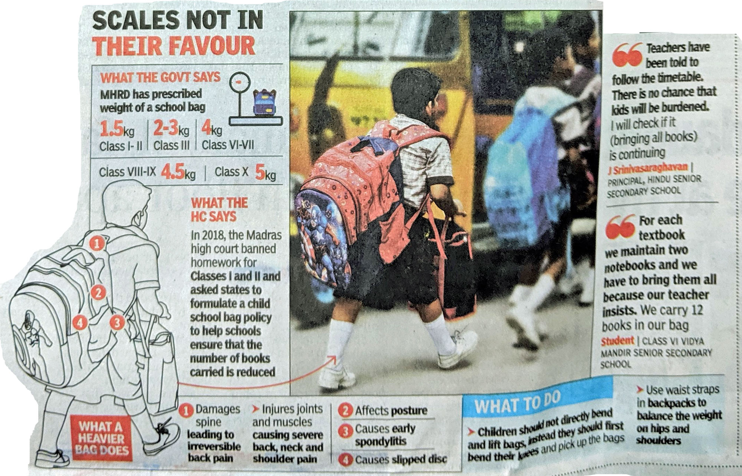

Problem Statement
Heavy Schoolbags carried by students causes spinal issues.

Slide 3
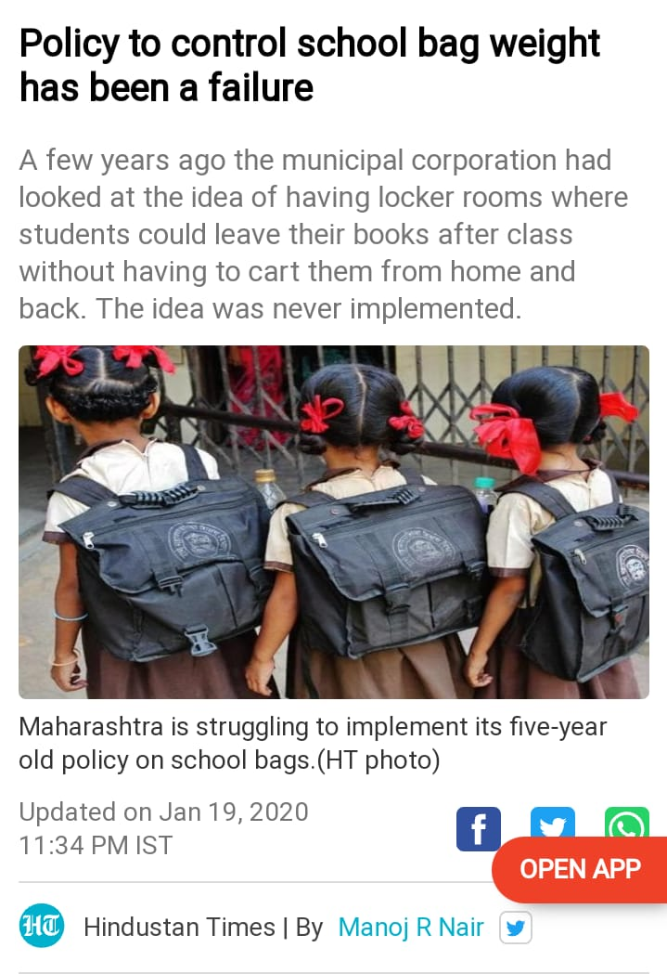
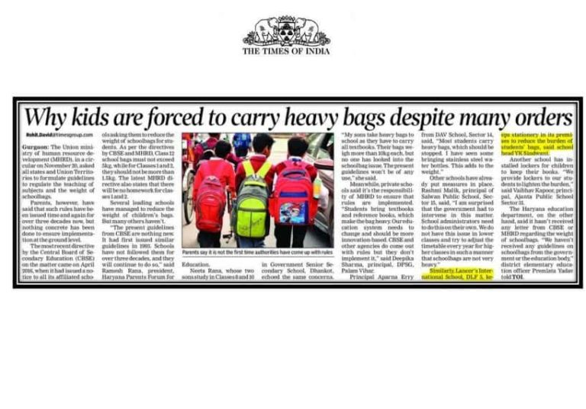

Slide 4
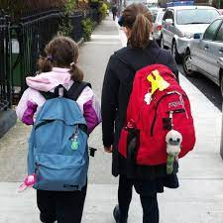
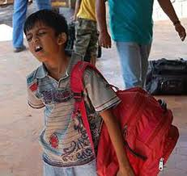
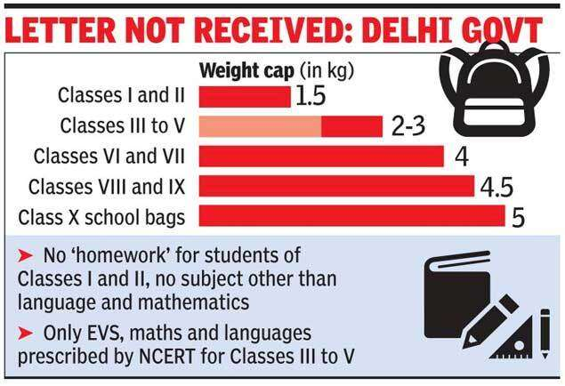
Introduction
For a long time, the government has been working on reducing the weight in school bags. Multiple schemes and projects have been implemented, but there is no proper solution to this problem. So here we are with a solution of Weighting Buddy.

Slide 5
Objectives:
To weigh the bag before kids go to school
To avoid future spinal problems
To decrease the daily back pains

Slide 6
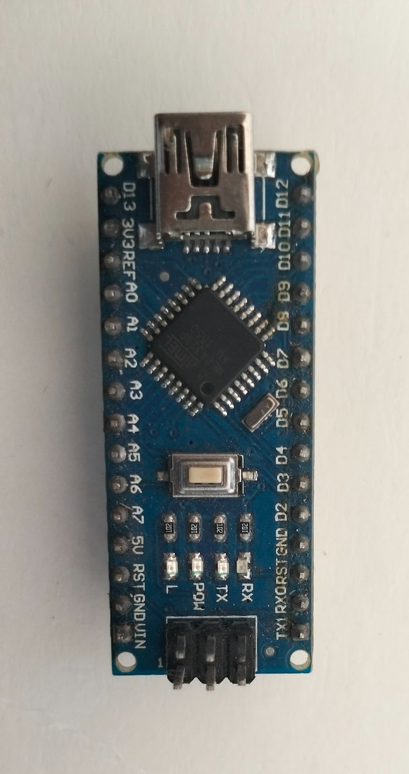
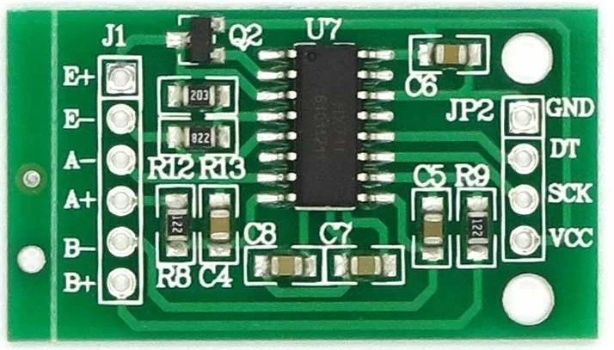
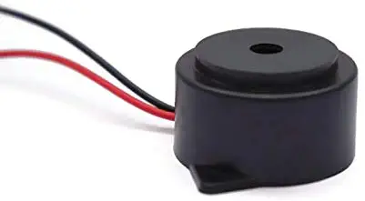
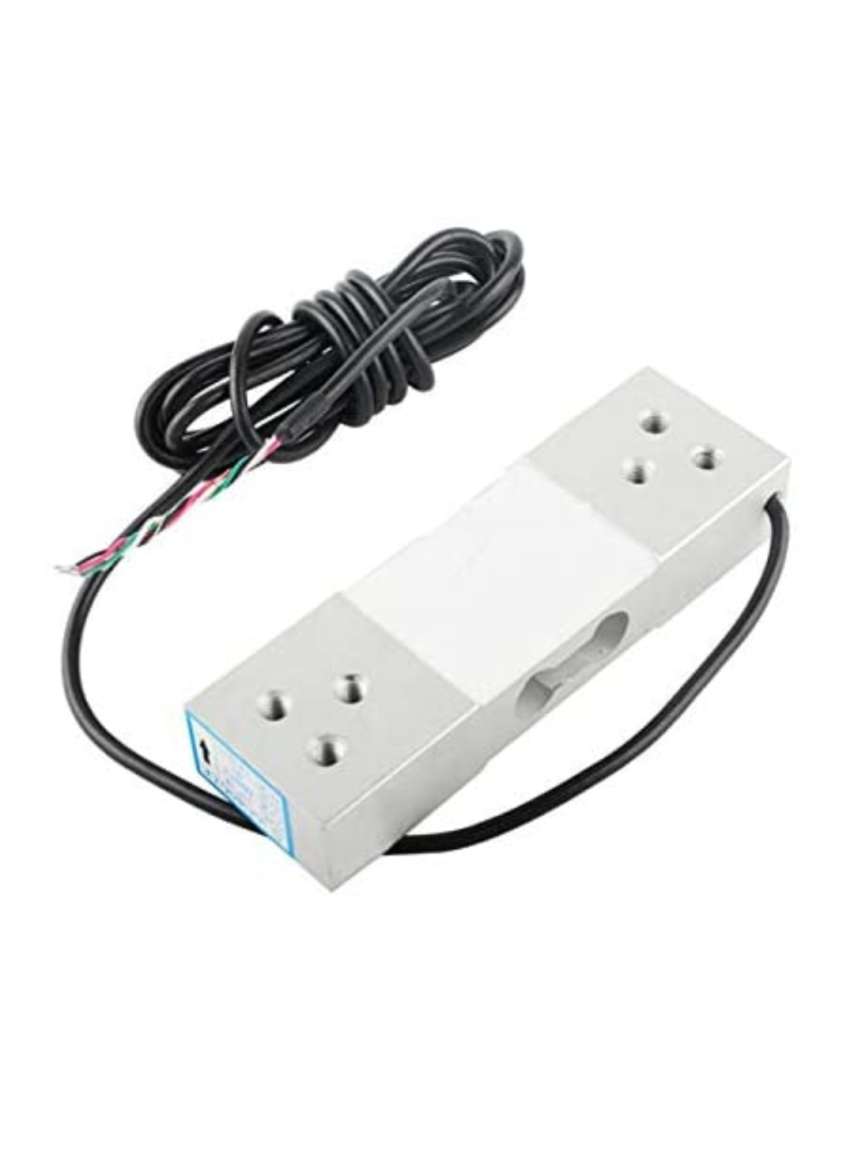
Components Used
Arduino Nano
HX711 Amplifier
Buzzer
Strain Gauge Load Cell

Slide 7
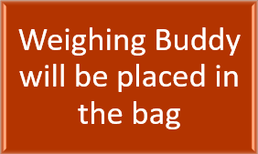


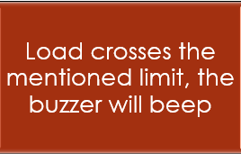
Working of Project

Slide 8

Future Plans
To reduce the size of by use of strain gauge chips
Reduction in the electronic circuit
Use of push button to turn off the buzzer for unavoidable situations
To modify this device that will allow the user to set weight limits according to their necessity

Slide 9

Result and Conclusion
So when the student fills his/her bag, if it is overweighted then the buzzer will beep letting him/her know how much weight he/she shall carry to school.

